Slide 1
Building Bridges: Strengthening Faith-Based Partnerships with Male Allies for Violence Prevention
This project was supported by Grant No. 15-OVW-22-GK-04007 awarded by the Office on Violence Against Women, U.S. Department of Justice. The opinions, findings, conclusions, and recommendations expressed in this publication/program/exhibition are those of the author(s) and do not necessarily reflect the views of the Department of Justice, Office on Violence Against Women.

Slide 2
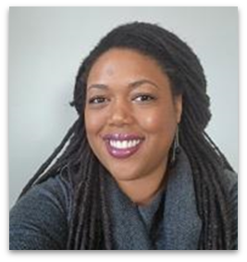
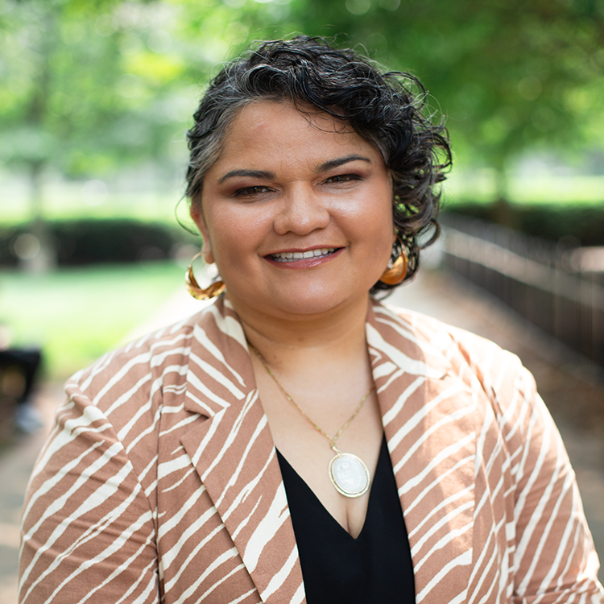
Our Presenters
Ayana Wallace Vieux, she/her, Ujima
Ayana is the Training and Technical Assistance Manager with Ujima, The National Center on Violence Against Women in the Black Community. Ujima is a nationally designated, culturally-specific resource center focused on Black women and girls and the Black community.
Sandy Ovalle Martinez, Sojourners -
Sandy is a table-setter and space-curator, rooting her work in the deep faith and strength of Chicanx and Latinx spiritual teachers. She is a native of Mexico City. A mujerista theologian and an organizer, she currently serves as the Director of Campaigns and Mobilizing for Sojourners in Washington, D.C., leading SojoAction, the mobilizing arm of Sojourners.

Slide 3
Webinar Overview
Our Objectives:
To underscore the importance of relationship building with male allies from the field and interfaith communities when doing prevention work.
To highlight best practices and key considerations to partnership and allyship building.
To hear directly from male allies and gain perspective about engagement strategies, challenges when engaging men, and their respective journeys in prevention work.

Slide 4
What does it mean to build bridges with male faith allies?

Slide 5
Groundwork for Relationships
Faith Communities as Spaces to Build Relationships
People of faith can play a significant role in undoing harmful traditions and teachings that uphold patriarchal structures and promote long endurance and suffering.
Churches can promote life-giving faith teachings, create safer structures, and cultivate communities of care that connect people with resources.
Men and male identifying individuals can benefit from affinity groups where they can share their experiences without shame, unlearn toxic beliefs, receive accountability and pursue justice.

Slide 6
Messaging Principles
How to Get People of Faith on Our Side: Messaging Principles
People move from emotions
We can get people to feel what we feel and do what we want them to do
Order matters: value-villain-vision
Value: What we are for
Villian: Origin story
Vision: Picture of a beautiful tomorrow
Adapted from Anat Shenker Osorio's Strategic Communications Framework and Nat Vikitsreth's Analysis of it.

Slide 7
Messaging Principles
How to Get People of Faith on Our Side: Messaging Principles
Value: In our community we value A
Villain: Doing B is out of line with the value we hold dear. It’s a choice we don’t have to keep making. (and B is a practice that perpetuates injustice)
Vision: We can make our community safer right now by doing C. (and C is your intentional community practices or teachings that are aligned with your values)
In our community we value A. Doing B is out of line with the value we hold dear. It’s a choice we don’t have to keep making. We can make our community safe right here, right now by doing C.
Adapted from Nat Vikitsreth'sProtect Your Peace this Holiday with this Political Messaging Strategy.

Slide 8
Groundwork for Relationships
Reclaiming and Reframing Religious Narratives to Build Allyship
Religious narratives have deep power to inspire hope and motivate change.
The purest and truest forms of our faiths promote life-giving ethics.
Christian narratives that portrait males as allies of women:
Jesus and the Samaritan woman – holding story as sacred
Jesus and the woman who was bleeding – using power to reclaim belonging.
Jesus and the woman "caught in adultery" – using creative reframing to point out abuses of a system by a powerful group
Paul reminding Timothy about his grandma and mother's wisdom and faith – honoring the wisdom and power of women.

Slide 9
Groundwork for Relationships
The Importance of Cultural Humility and Awareness in Building Bridges with Male Allies
Culture shapes reality and experience.
Culture influences expressions of both identity and faith.
It is a process to unlearn behaviors or beliefs that are seemingly rooted in culture.
Male allies in gender-based and intimate partner violence prevention work are needed as models for the community.
Male allies may be able to better articulate to other men and boys what this work means culturally and socially.

Slide 10
Best Practices and Key Considerations for Building Partnerships
Steps to strengthen faith-based partnerships:
Building trust and rapport
Checking bias and assumptions
Having full and layered conversations about experience, insight, and injury
Making the case – importance of diverse cultural and religious perspectives
Promoting active participation and collaboration
Do not assume that you can add men and boys at the end of your prevention planning efforts and that your efforts will automatically be nuanced or received well

Slide 11
Jamerson Watson
Jamerson is an anti-violence and housing justice advocate with over 20 years of experience supporting communities across the US. Jamerson is currently co-founder and principal at Liberation In Action, Inc, a consulting group that seeks to ensure liberation is at the forefront of all diversity, equity, and inclusion work. Using an anti-oppression framework, LIA offers consultation, training, and coaching to organizations, companies, and groups working toward a more just community.
Prior to forming LIA, Jamerson was a Senior Program Manager at CSH, an organization working to advance solutions using housing as a platform to improve the lives of the most vulnerable people and build healthy communities. He has worked in the gender-based violence prevention field for two decades, including as the National Project Director for the Lethality Assessment Program (LAP) at the Maryland Network Against Domestic Violence, as the Program Director for the Sexually Exploited Minors Program at Bay Area Women Against Rape, and as the National Director for Transforming Communities (TC-TAT), a project of the Center for Domestic Peace, delivering TTA to DV service providers in the US and its territories. Jamerson has worked with several rape crisis centers, managed batterer intervention programs, supported housing programs, and provided training, technical assistance, and outreach for several organizations across the country.

Slide 12
Rick Chamiec-Case
Rick Chamiec-Case
Rick Chamiec-Case serves as the Executive Assistant to the President and HR Manager at Sojourners. Rick has B.A. in philosophy from Wheaton College, a M.A.R. from Yale Divinity School, a M.S.W. from the School of Social Work at the University of Connecticut, and a Ph.D. in social work from Fordham University.
Before coming to Sojourners, Rick was a consultant for faith-based nonprofit organizations for the past two years, and prior to that, he was the executive director of the North American Association of Christians in Social Work as well as the managing editor of Social Work and Christianity from 1997-2021. In the 1990s, Rick was senior vice president at ARI of Connecticut, which provides homes and jobs for people with disabilities. Rick has written and presented at conferences on various topics addressing the ethical integration of faith and social work and has research and scholarship interests in the areas of spirituality in the workplace and faith-based social services.
Rick has been a co-leader of an interfaith group committed to refugee resettlement as well as a co-leader of an interfaith gun violence prevention committee of CONECT in the state of Connecticut. He is a lay leader at St. John’s Episcopal Church in Bridgeport, Conn.

Slide 13
Insights from Male Allies: Personal Journey, Challenges, and Role
Discussion Questions
How would you describe your journey in intimate partner and gender-based violence work?
Can you share some challenges you've faced and lessons you've learned in your journey as a male ally, particularly in terms of personal growth and leadership?
In your opinion, what does it mean to be a male ally? And is there different language that we could use to be more inclusive of men and boys in this work?
What are the main functions you fulfill in your role as a male ally?
Based on your experience, is there a lack of male voice in discussions around violence prevention?

Slide 14
Insights from Male Allies: Practical Advice and Strategies
Discussion Questions
How does the concept of protection within faith gender norms influence the role of men and boys of faith in preventing gender-based violence? Can and should the concept of protection be incorporated into community-based prevention efforts when working with men and boys of faith?
How do you navigate the balance between having a male presence and ensuring female leadership isn't overshadowed in violence prevention initiatives?
What advice would you give to organizations seeking to establish connections with men and boys of faith?

Slide 15
Insights from Male Allies: Practical Advice and Strategies
Discussion Questions
What resources have been helpful to you? Would be helpful to other men and boys in this work or within our various faith communities?
For men and boys within faith communities?
For women and girls in faith communities trying to engage men and boys?
People outside of faith communities trying to engage men and boys?

Slide 16
Q&A on Building Bridges

Slide 17
Contact Information
Jamerson Watson, Co-Founder and Principal at Liberation In Action, Inc., jamerson.watson@gmail.com
Ayana Wallace Vieux, Training and Technical Assistance Manager, awallace@ujimacommunity.org
Sandy Ovalle, Campaigns & Mobilizing Director, sovalle@sojo.net

Slide 18
Additional Resources
Religion and Domestic Resources by VAW
Resource Packet on Religion and Domestic Violence from NRCDV
"Domestic Violence in Faith-based Settings" by Center for Domestic Peace
"Creating Safe Faith Communities" by PCADV
"Faith Communities Call to Action: Engaging Men & Boys Toolkit" by PCADV
"THE POWER OF SEXUAL VIOLENCE PREVENTION IN FAITH COMMUNITIES" by the National Sexual Assault Conference

Slide 19
Upcoming Opportunities
Office hours: 2nd Thursday of Each Month, 1:00 PM EST – Beginning August 10th
Find additional resources and upcoming programs at: https://www.jwi.org/ovwfaithtta

